Slide 1
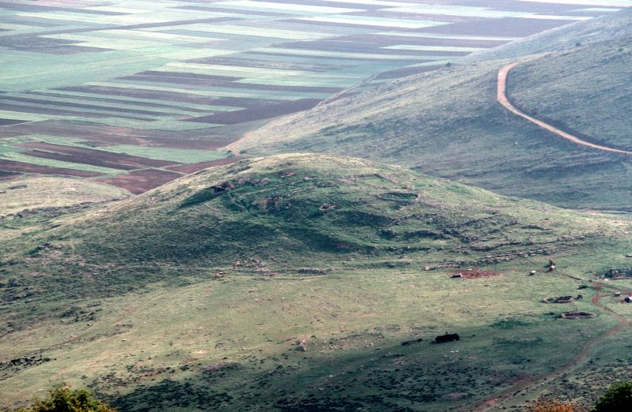
Khirbet Qana: Likely location of Cana
Photo courtesy of holylandarchive.com
John 2.1-12

Slide 2
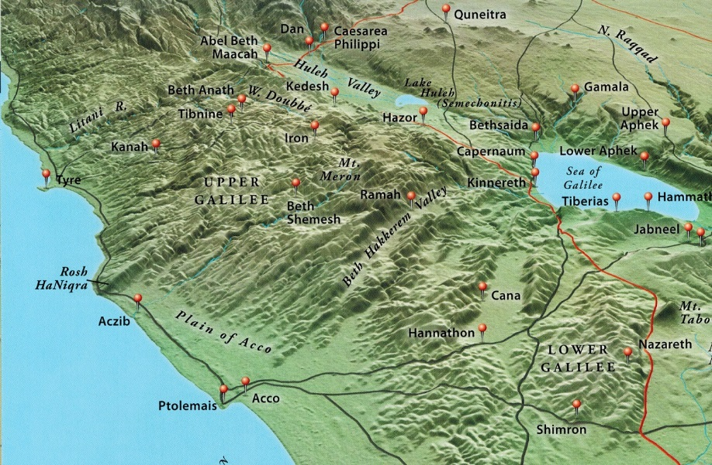
John 2.1-2 [NET]: Now on the third day there was a wedding at Cana in Galilee. Jesus' mother was there, and Jesus and his disciples were also invited to the wedding.
Map: Rasmussen, Zondervan Atlas of the Bible, 36

Slide 3
John 2.1-2 [NET]: Now on the third day there was a wedding at Cana in Galilee. Jesus' mother was there, and Jesus and his disciples were also invited to the wedding.

Slide 4
John 2.3-5: When the wine ran out, Jesus' mother said to him, “They have no wine left.” Jesus replied,
“Woman, why are you saying this to me? My time has not yet come.” His mother told the servants, “Whatever he tells you, do it.”

Slide 5
John 2.3-5: When the wine ran out, Jesus' mother said to him, “They have no wine left.” Jesus replied,
“Woman, why are you saying this to me? My time has not yet come.” His mother told the servants, “Whatever he tells you, do it.”

Slide 6
John 2.3-5: When the wine ran out, Jesus' mother said to him, “They have no wine left.” Jesus replied,
“Woman, why are you saying this to me? My time has not yet come.” His mother told the servants, “Whatever he tells you, do it.”

Slide 7
John 2.3-5: When the wine ran out, Jesus' mother said to him, “They have no wine left.” Jesus replied,
“Woman, why are you saying this to me? My time has not yet come.” His mother told the servants, “Whatever he tells you, do it.”

Slide 8
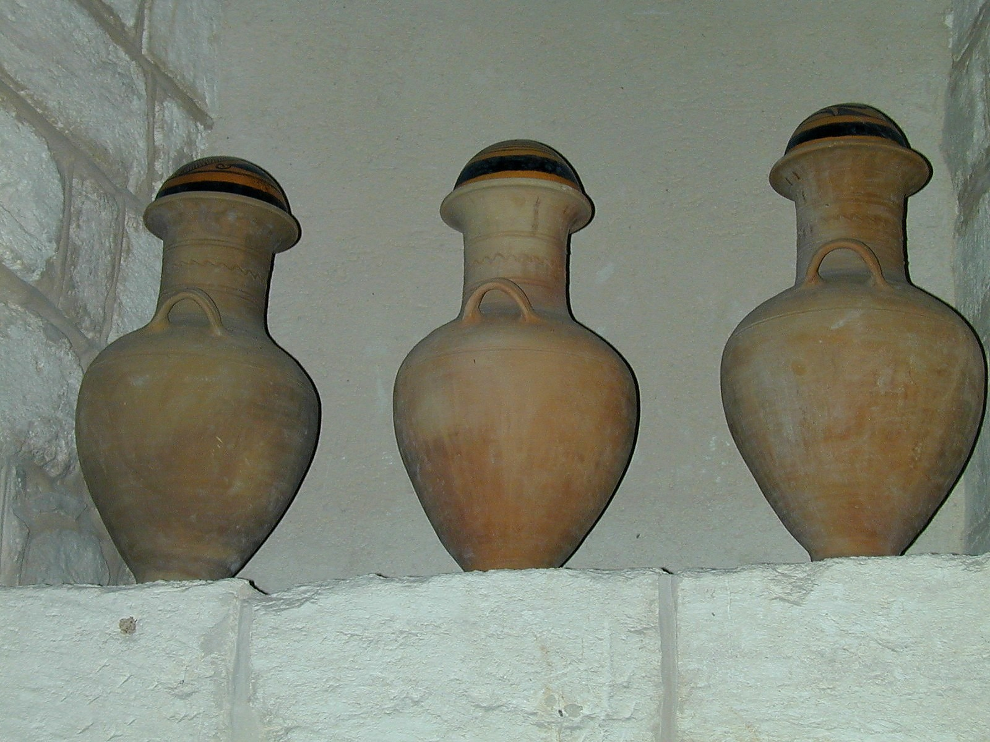
John 2.6: Now there were six stone water jars there for Jewish ceremonial washing, each holding twenty or thirty gallons.
Image courtesy of Todd Bolen; bibleplaces.com

Slide 9
John 2.7-10: Jesus told the servants, “Fill the water jars with water.” So they filled them up to the very top. Then he told them, “Now draw some out and take it to the head steward,” and they did. When the head steward tasted the water that had been turned to wine, not knowing where it came from (though the servants who had drawn the water knew), he called the bridegroom and said to him,
“Everyone serves the good wine first, and then the cheaper wine when the guests are drunk. You have kept the good wine until now!”

Slide 10
John 2.11-12:
Jesus did this as the first of his miraculous signs, in Cana of Galilee.
In this way he
revealed his glory,
and his disciples
believed in him.
After this he went down to Capernaum with his mother and brothers and his disciples, and they stayed there a few days.
Map: Rasmussen, Zondervan Atlas of the Bible, 36

Slide 11
John 2.11-12: Jesus did this as the first of his miraculous signs, in Cana of Galilee. In this way he revealed his glory, and his disciples believed in him. After this he went down to Capernaum with his mother and brothers and his disciples, and they stayed there a few days.
Prophets foretold the Messiah would deliver Israel to a time of peace and prosperity, in which wine would flow abundantly.
Jesus is this Messiah,
who will fulfill God’s promises to Israel.

Slide 12
John 2.11-12: Jesus did this as the first of his miraculous signs, in Cana of Galilee. In this way he revealed his glory, and his disciples believed in him. After this he went down to Capernaum with his mother and brothers and his disciples, and they stayed there a few days.
John the Baptist and the apostles John and Paul call Jesus the bridegroom of the church.
Jesus made good the deficiency of this bridegroom, in anticipation of his perfect provision for the church.

Slide 13
John 2.11-12: Jesus did this as the first of his miraculous signs, in Cana of Galilee. In this way he revealed his glory, and his disciples believed in him. After this he went down to Capernaum with his mother and brothers and his disciples, and they stayed there a few days.
Prophets foretold a time when the New Covenant would replace the Mosaic.
Jesus later used wine to symbolize that he would inaugurate the New Covenant with his blood.

Slide 14
Powerful enough to do miracles, even to change creation/nature
Bridegroom to the church, sacrificially providing salvation, cleansing, and protection
Messiah/Christ who will fulfill God’s promises to Israel
Messiah/Christ who brings New Covenant blessings
Who is Jesus?

